Slide 1
Helsby High School
Year 10 Information Evening
achieve SUCCESS BY VALUING OTHERS

Slide 2
Overview of the Evening
The ‘Road to Success’ for KS4
The curriculum journey
Core Subjects
Wider subject support
Academic target setting, assessment and reporting
Personal development and enrichment opportunities
Pastoral support

Slide 3
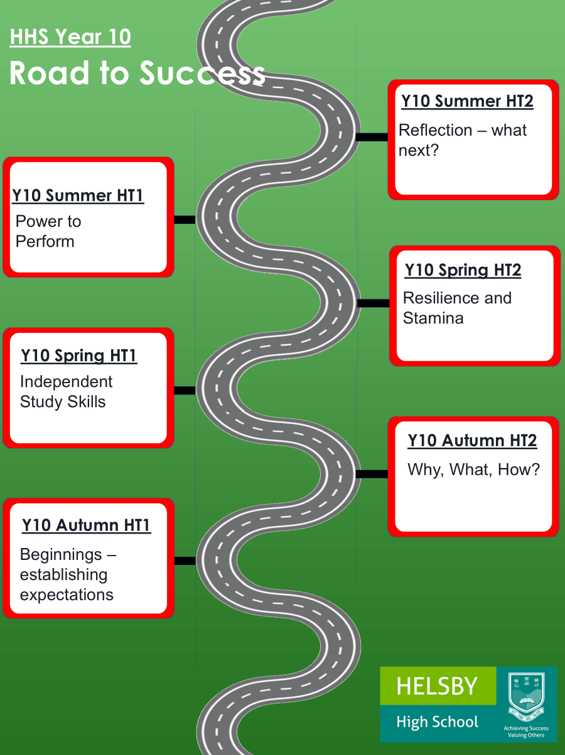

Slide 4
The curriculum journey
All students complete GCSE courses in the following:
English Language
English Literature
Maths
Sciences (either Combined Science worth 2 GCSEs or Separate Science worth 3 GCSEs)
Geography, History, French or German
Three further free option choices

Slide 5

What students are learning

Slide 6
What students are learning

Slide 7
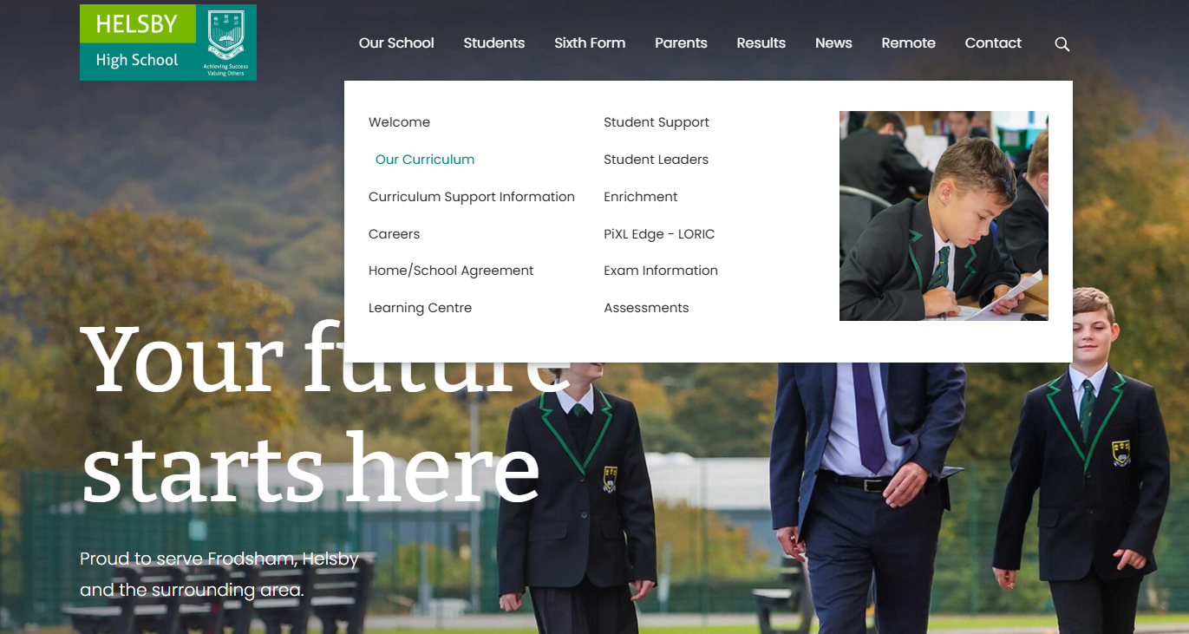
What students are learning

Slide 8

What students are learning

Slide 9
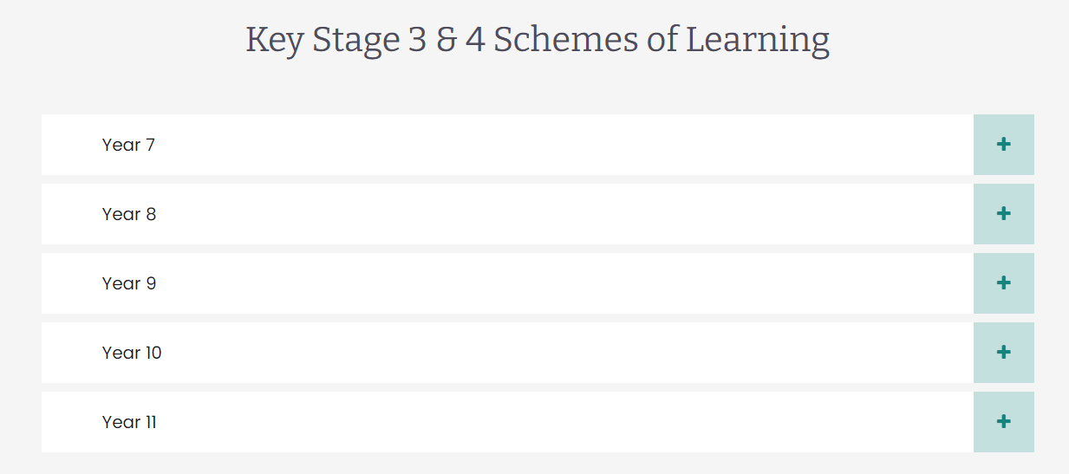
What students are learning

Slide 10

What students are learning

Slide 11
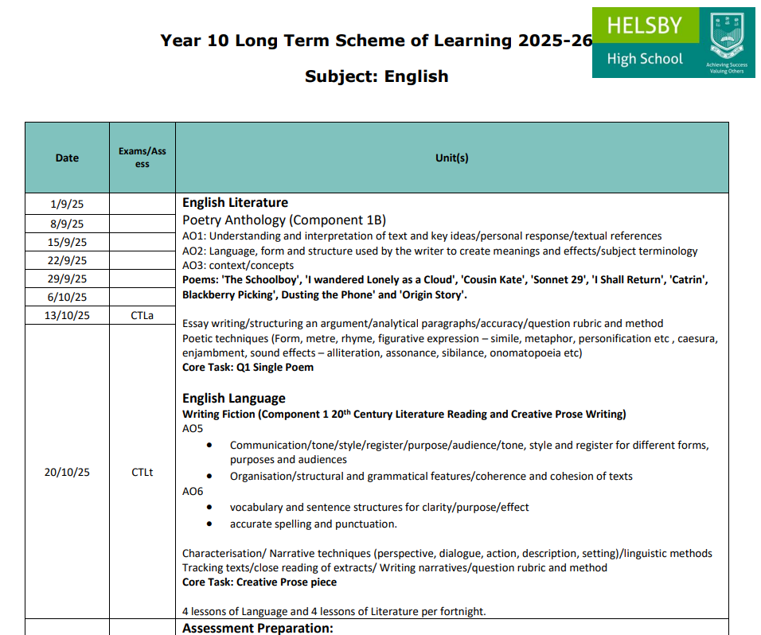
What students are learning

Slide 12
What does a typical lesson look like

Slide 13


Classroom Expectations
1
2
3
4
Establish routines for behaviour and high expectations for a positive learning environment
Use a trauma informed approach to build positive relationships founded on mutual trust and respect
Share learning intentions and success criteria and use these effectively to assess students’ understanding
Support students to maintain consistently high standards of quality and presentation of work
5
6
7
8
Immediately engage students with an effective recall of knowledge and/or skills activity
Use a variety of engaging and challenging tasks
Incorporate activities to develop students’ vocabulary, disciplinary reading and oracy
Provide effective regular formative and summative feedback and provide time for student response
Achieving Success by Valuing Others

Slide 14
How students receive feedback
Verbal feedback – each lesson
Written feedback – at least once per half term on a significant piece of work a ‘core task’

Slide 15
Homework and independent study
Department | KS3 Expectations | KS4 Expectations | KS5 Expectations
English & Media | 30-60 mins per week | 60-120 mins per week | Students are expected to spend one hour on independent learning for every hour of lessons taught.
Maths | 30-60 mins per week | 60-120 mins per week
Science | 30-60 mins per week | 60 mins per week
MFL | 20-30 mins per week | 30 mins per week
Geography | 60-120 mins per half term | 30 mins per week
History & Politics | 60-120 mins per half term | 30 mins per week
Art | 60 mins per half term | 30 mins per week
Business, Computing and Economics | 60 mins per half term | 30 mins per week
Performing Arts | 60 mins per half term | 30 mins per week
P.E | 60 mins per half term | 30 mins per week
Social Sciences | 60 mins per half term | 30 mins per week
Technology | 60 mins per half term | 30 mins per week

Slide 16
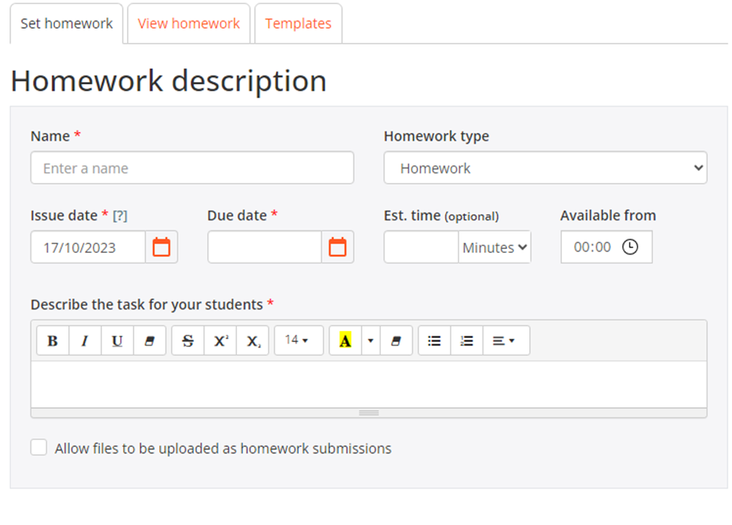
Homework and independent study

Slide 17
Core Subject Support
Achieving at least a Standard Pass (Grade 4) in English, Maths and Science is a requirement for most post-16 colleges, apprenticeships and employment.
Students spend the majority of their curriculum time devoted to studying these subjects.
Important to prioritise their independent study
As a school we support by prioritising our interventions and support in these areas.

Slide 18
GCSE English Language
We follow the Eduqas Examination Board specification.
The aim of the course is to enable students to:
read a wide range of texts, fluently and with good understanding
read critically, and use knowledge gained from wide reading to inform and improve their own writing
write effectively and coherently using Standard English appropriately
use grammar correctly, punctuate and spell accurately
use spoken Standard English effectively

Slide 19
GCSE English Language
There are two examined components:
Component 1: 20th Century Literature Reading and Creative Prose Writing
Worth 40% of the overall grade. Exam is 1 hour 45 minutes.
Component 2: 19th and 21st Century Non- Fiction Reading and Transactional Writing
Worth 60% of the overall grade. Exam is 2 hours.
Each component has a reading and a writing section. In the writing section students will be assessed on their spelling, punctuation and grammar.
Students will also complete a spoken endorsement which will assess their speaking and listening skills. Students will be awarded a pass, merit or distinction and this will be reported on their examination certificate.

Slide 20



GCSE English Language
Revision:
Your child’s exercise book will provide a solid foundation for revision and additional revision resources will be shared vis Class Charts and Teams. We also use Seneca Learning for revision activities and these will be set for homework in preparation for assessments or core tasks. In Year 11 we will regularly share practice papers.
CGP, Pearson and Oxford University Press all produce useful revision guides and workbooks. If you do decide to purchase these to support your child then please make sure they are for the Eduqas Examination board.

Slide 21
GCSE English Literature
We follow the Eduqas Examination Board specification.
The aim of the course is to enable students to:
read a wide range of classic literature fluently and with good understanding, and make connections across their reading
read in depth, critically and evaluatively, so that they are able to discuss and explain their understanding and ideas
develop the habit of reading widely and often
write accurately, effectively and analytically about their reading, using Standard English
acquire and use a wide vocabulary, including the grammatical terminology and other literary and linguistic terms they need to criticise and analyse what they read.

Slide 22

GCSE English Literature
There are two examined components:
Component 1: 20th Shakespeare and Poetry
Worth 40% of the overall grade. Exam is 2 hours.
Our set texts are Macbeth and the exam board’s Poetry Anthology
Component 2: Post 1914 Drama/19th Century Prose and Unseen Poetry
Worth 60% of the overall grade. Exam is 2 hours and 30 minutes.
Our set texts are An Inspector Calls and A Christmas Carol

Slide 23
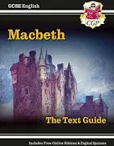





GCSE English Literature
Your child’s exercise book will provide a solid foundation for revision and additional revision resources will be shared vis Class Charts and Teams. We also use Seneca Learning for revision activities and these will be set for homework in preparation for assessments or core tasks. In Year 11 we will regularly share practice papers.
CGP and Oxford University Press both produce useful revision guides. If you do decide to purchase these, to support your child, please make sure they are for the Eduqas Examination board or not exam board specific.

Slide 24
GCSE Mathematics
Edexcel Maths Exam Board
Foundation Grade 1 – 5
Higher Grade 3 – 9
3 papers, all 1 hour and 30 minutes long.
Paper 1 in non calculator, Paper 2 and 3 are both calculator.

Slide 25
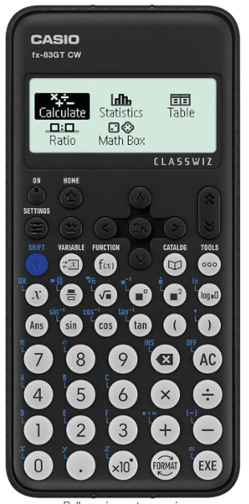
GCSE Mathematics
Please have a scientific calculator for every lesson. We recommend a Casio but any are fine.
Maths Homework is on Sparxs Maths in Year 10. Set every Tuesday for the following Tuesday.
Maths Homework in Year 11 a weekly half a past paper.

Slide 26
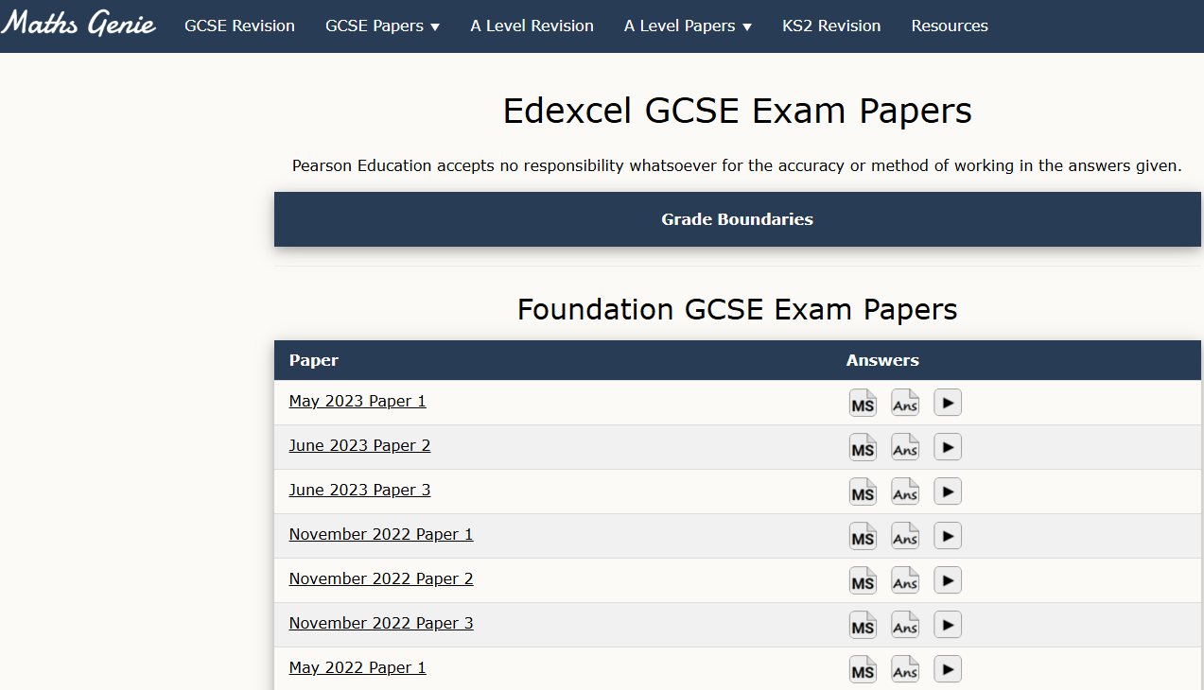
GCSE Mathematics
The best way to revise Maths is completing past papers.
The best website is https://www.mathsgenie.co.uk/

Slide 27
GCSE Sciences
All students have 3 teachers: biology, chemistry and physics.
They are set (~) 1 hour of Seneca homework fortnightly as well as other independent learning tasks.
The homework is to support students remember core knowledge. Teachers check the homework and respond to it in lessons (in the form of 10 minutes starter tasks/reteach).
Recall of knowledge is key to remembering information. The best way to help your child is to QUIZZ them. Get them to make the flashcards themselves!
Notes:
Can I go through the Leitner System here? I can bring my tubs with me ☺

Slide 28
GCSE Sciences – useful websites
Teams – join the science combined/separates class of 2026 Teams.
Cognitio – videos, past papers and topic questions.
Free Science Lessons – all of the science specification. Can buy workbooks too.
Kay Science channel – YouTube
AQA Website – lots of past papers.

Slide 29
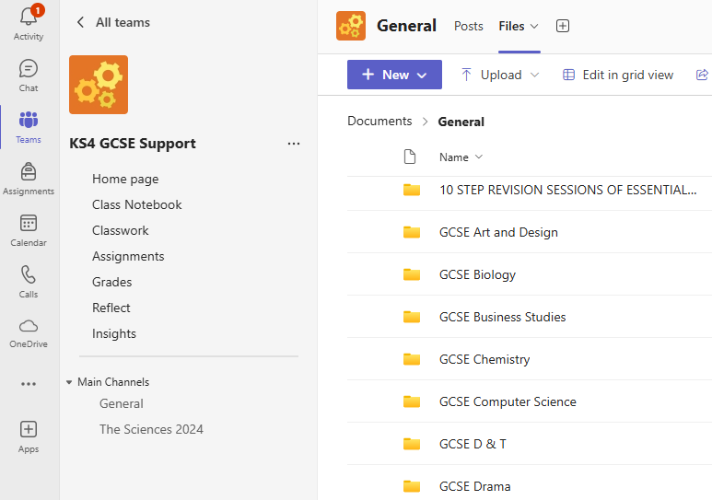
Wider Curriculum Support

Slide 30
Academic Targets
An aspirational but realistic level of attainment each student should be aiming to achieve.
We follow the same method as the Department for Education (DfE) to generate GCSE Targets for students based on their KS2 prior attainment, i.e. their SAT scores.
We use this KS4 GCSE target to inform our end of year targets for students across the 5 years of study.
Target grades are used as a basis to measure students’ attainment and progress.

Slide 31
How we assess students’ progress
Informal assessments throughout the academic year in lessons.
Classwork and homework.
Formal summative assessment fortnights during the academic year:
w/c 16th November 2026
w/c 19th April 2027
In lesson assessments across all subject areas. Core Exams hosted in formal exam setting at the end of the year.
Students given a timetable and Supporting Information Booklet to aid their revision preparation.

Slide 32
How to support students with assessment preparations
Encourage students to create a revision timetable for their assessments.
Revision is most effective in short chunks of time, i.e. 2 lots of 20 minutes.
Establish a routine for their independent study at home.
Make sure they have the resources and equipment they need.
Create a quiet environment for them to study.
Offer encouragement and support.

Slide 33
How we report students’ progress
We issue an Academic Progress Summary Report twice a year following the Assessment Fortnight. These will be issued:
w/c 14th December 2026
w/c 24th May 2027
Reports are issued to parents/carers via the SIMs Parent App and hard copies are issued to students to take home.
We will hold a face-to-face Consultation Evening on Thursday 4th February 2027.

Slide 34
How we use assessment data
Teachers and Form Tutors will discuss student attainment and progress with them.
Students and teachers will identify the specific areas of strength and development from the assessments.
This is then used to inform future teaching and learning.
We foster a culture of high aspiration and a love of learning to ensure students maximise their progress and potential.
Achieve success by valuing others

Slide 35

Personal Development
“The curriculum provided by schools should extend beyond the academic, technical or vocational. Schools should support pupils to develop in many diverse aspects of life.”

Slide 36


HHS Character Profile
Being Respectful means to be polite and show honour to someone or something.
Being Ambitious means you have or show a strong desire and determination to succeed and make your life better.
Being Empathetic means you are able to understand and share the feelings of another person, even if they are a very different person to you
Being Resilient means you are able to withstand or recover quickly from difficult situations.

Slide 37


Slide 38

Experience of the Workplace
Monday 12th July – Thursday 15th July, 2027
This is a great opportunity for students to gain an understanding of the ‘world of work’, whilst developing employability skills which will enable them to make competitive applications to any Sixth Form, college or apprenticeship.
Four days individual, face to face experience
Students will need
· Business name and full address including post code
· Employer contact name
· Employer contact email address
· Parent or guardian name and email address
The first self-placement deadline is Friday 12th February. Students should have entered all the details on Unifrog by this date

Slide 39





Who can help me find a placement
Family
Friends
Neighbours
Exploring the
local labour market
School careers
team

Slide 40



How to email Businesses
If you don’t hear back from the employer, it’s a good idea to phone them or visit them, if they are local to where you live.
Include the dates you want to visit
12th -15th July
Explain why you are interested in their business (Skills, knowledge or both)
Be professional and polite– check your spelling and don’t use abbreviations
Use your school email address
Unifrog
*Please can you add noreply@unifrog.org
to your safe sender list /whitelist.

Slide 41































Slide 42

Sixth Form Helsby Transition Events
Event | Outcome
Sixth Form Open Event | Find out about the courses that interest me – Thursday 8th Oct
Life After GCSE Day | Find out what ‘doors’ Level 3 subjects could open, sample life in the Sixth Form and understand the ‘step up’ from GCSE level – Monday 28th June
Taster Days | Sample the subjects and work with subject specialists - During Y11
Ask a Sixth Former Sessions | Speak to Sixth Formers and find out what it is like to study and socialise at Sixth Form Helsby
Course consultation Evening | Speak to the teachers and subject leads about your suitability for these Level 3 subjects and find out what you need to do ‘NOW’ to achieve as highly as you can later.
Enrolment Morning | Talk to students on your courses and see the work they have produced to date.
Valuing Young Voices, Fostering Future Achievements

Slide 43
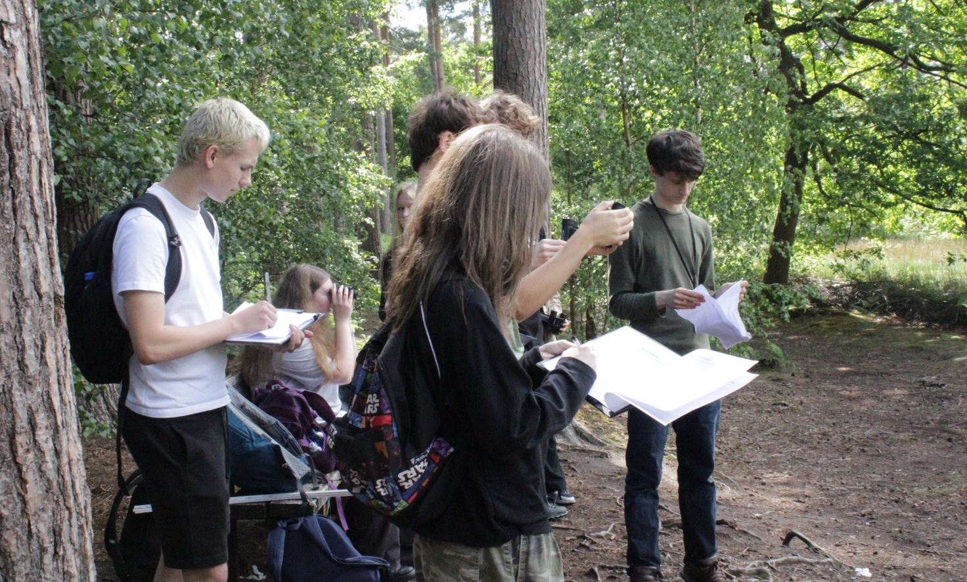
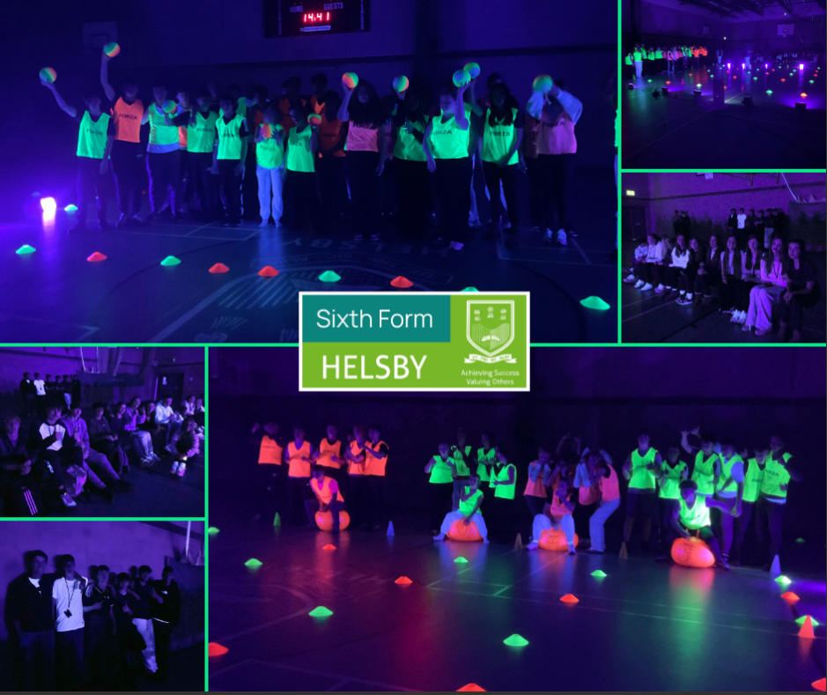
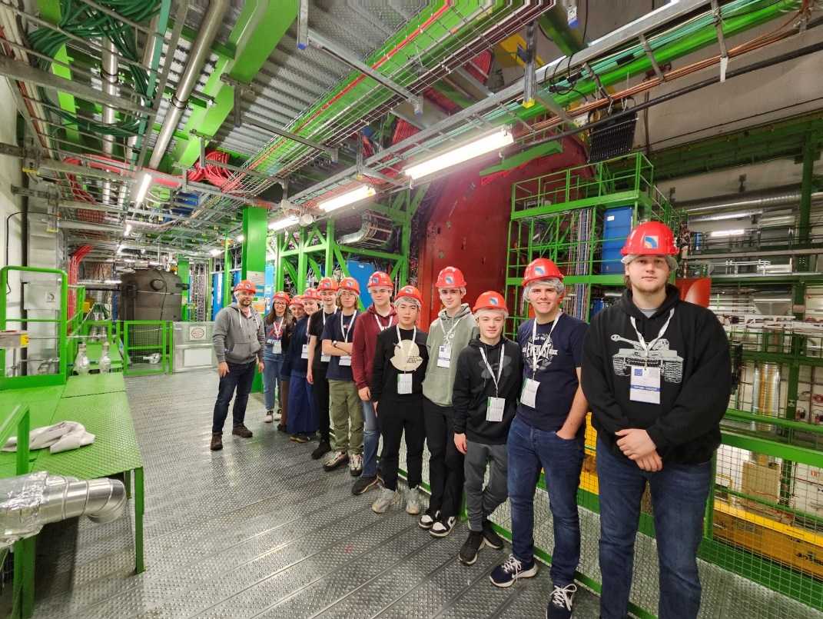
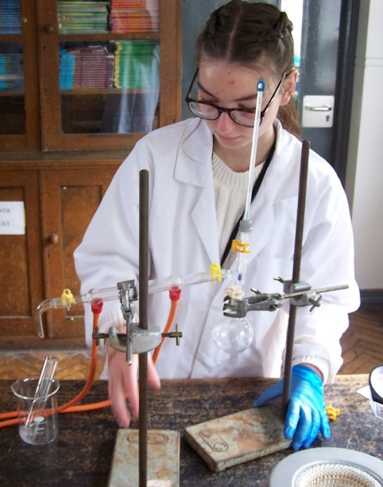
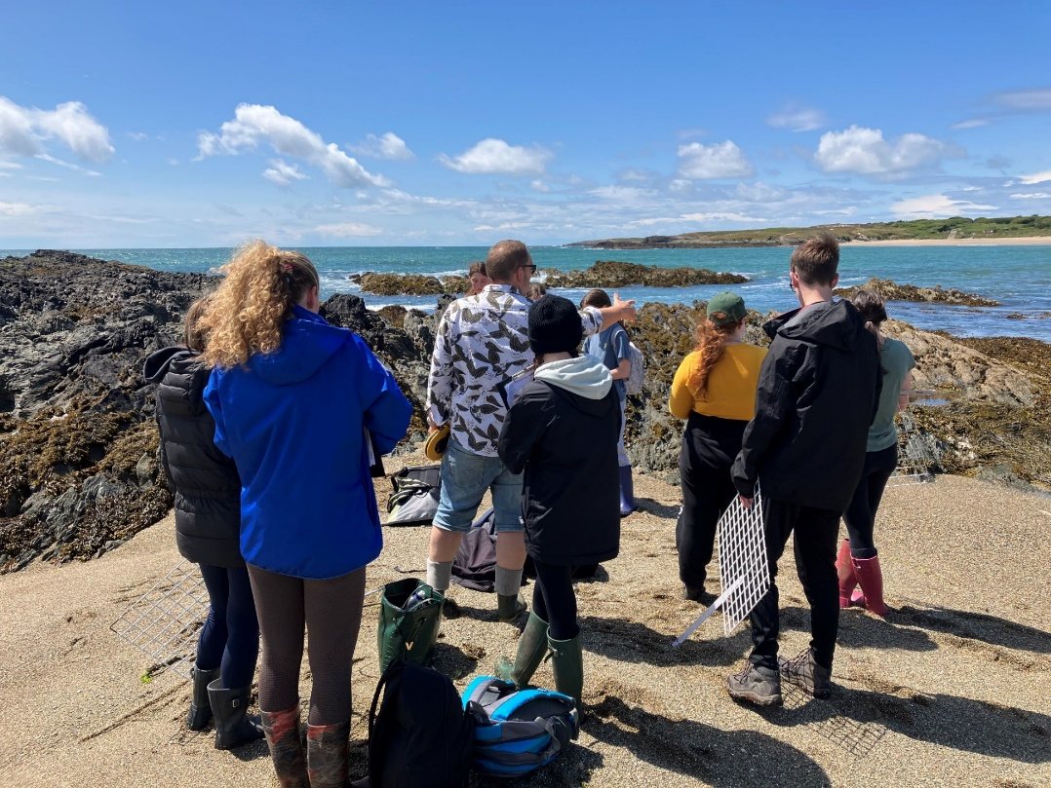
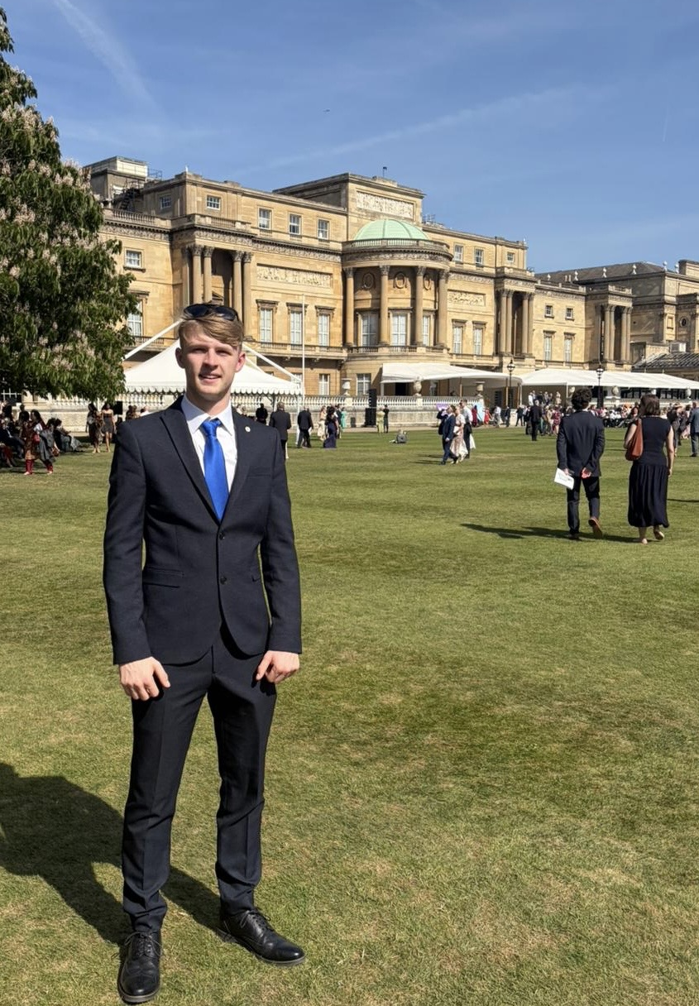

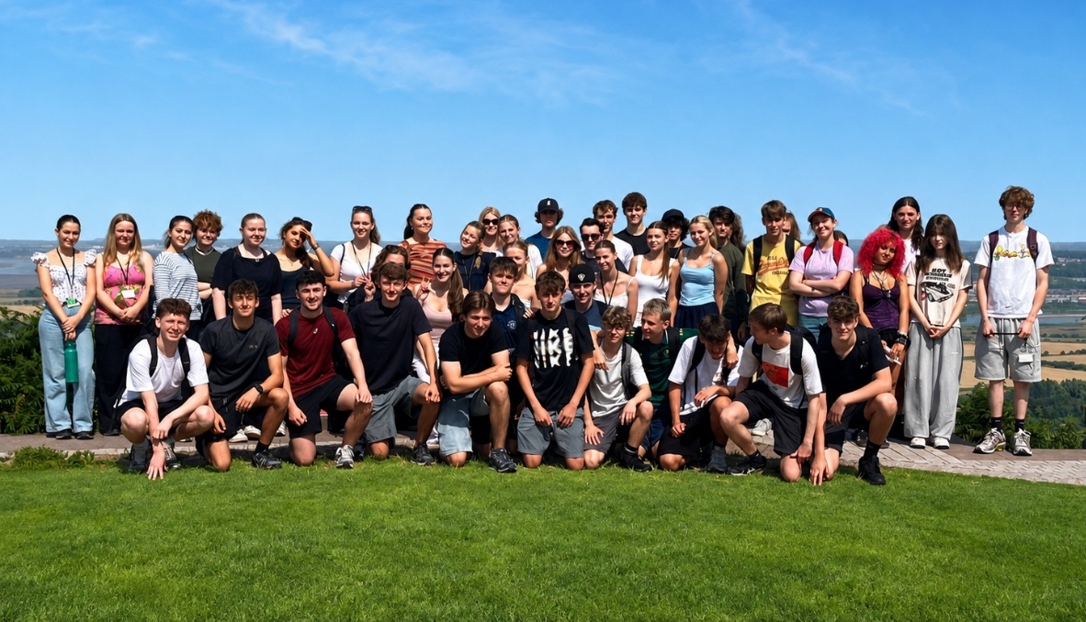
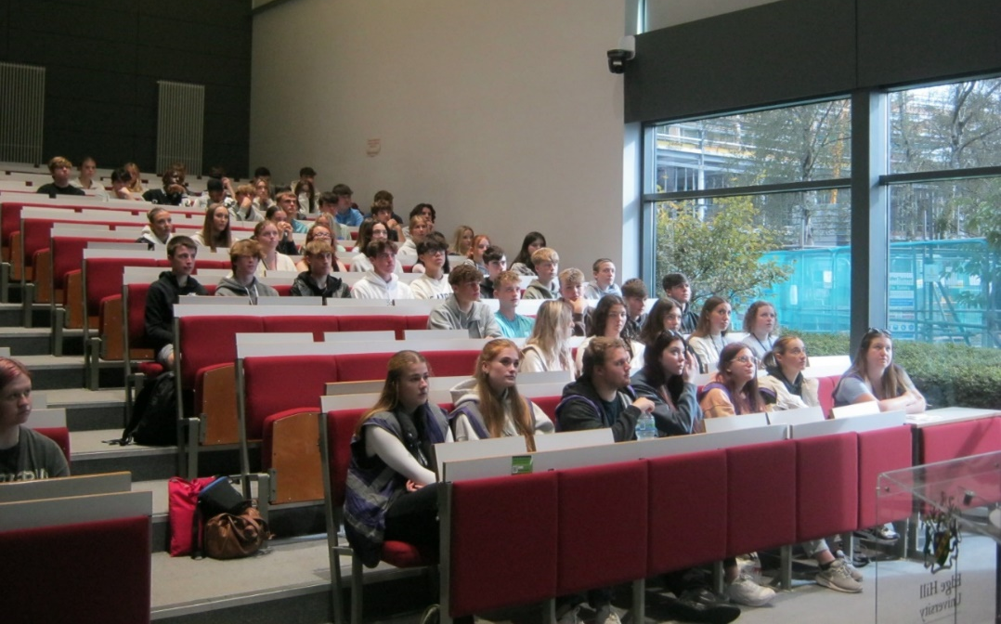
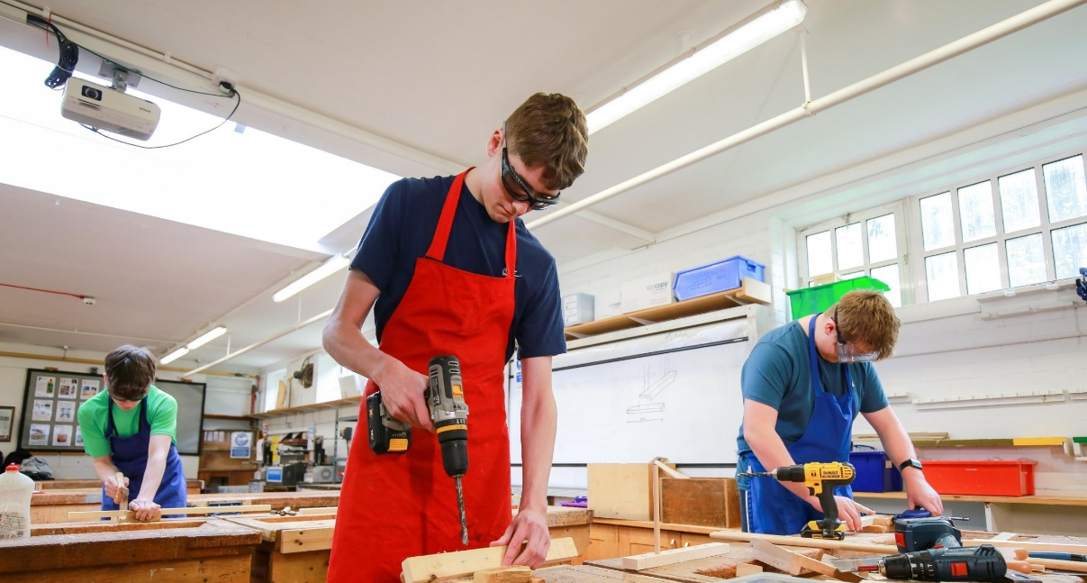
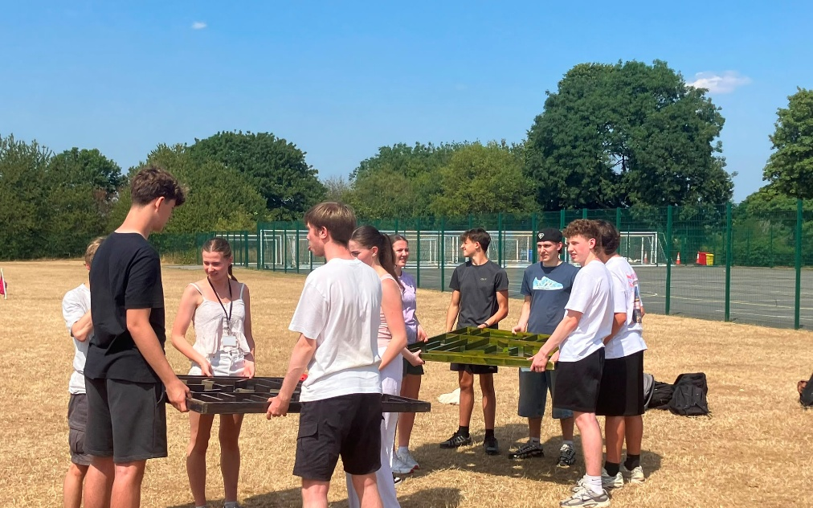

Slide 44
Pastoral Support
The Pastoral Team
Deputy Headteacher (Behaviour & Culture) – Mrs S Warburton
Year 10 Progress and Pastoral Lead – Miss N Ryan
Student Support Co-Ordinator – Miss E Dowling

Slide 45
Adjusting to Year 10
Academic pressure – increase in workload and high-stakes assessments.
Coursework – Certain courses require students to complete coursework over an extended period, which can increase pressure if they have missed lessons.

Slide 46
Support and wellbeing
Pastoral drop-ins – students seeking support can reach out to the pastoral team, which also offers mindfulness activities to help manage feelings of overwhelm
Academic guidance – the team are there to support students to create realistic study plans, guide them to resources and help them balance their schoolwork with social time.

Slide 47
Form Time
Form time plays a vital role in supporting both the academic and personal development of students.
Reviewing academic progress
Addressing concerns
Preparing students for their PPEs

Slide 48
The Importance and
Impact of Attendance
The table below shows the percentage of students at Helsby High School in 2026 who achieved at least a Standard Pass or at least a Strong Pass in their English AND Maths in 2026 based on their overall attendance to school in Y11.
Attendance in Y11 | English and Maths at Grade 4+ | English and Maths at Grade 5+
Above 95% | 92 | 68
Between 90% and 95% | 72 | 45
Between 85% and 90% | 57 | 36
Less than 85% | 27 | 11

Slide 49

ACHIEVE SUCCESS
BY
VALUING OTHERS

